Slide 1
Artwork Converter
( neural style transfer)
Laura Luo
08/2019

Slide 2
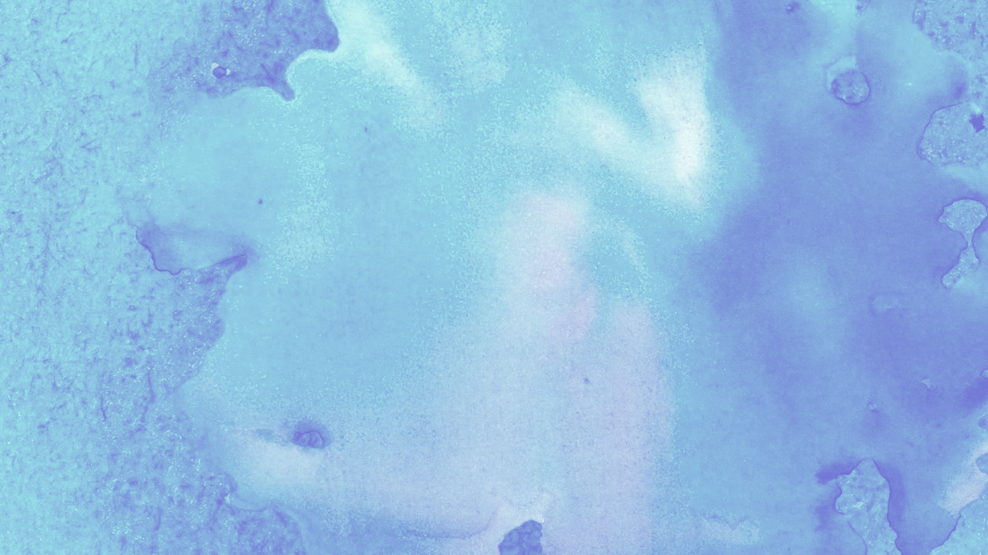
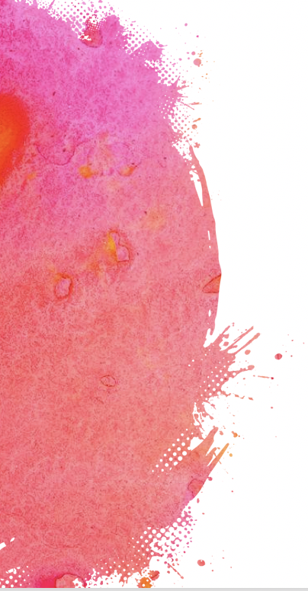

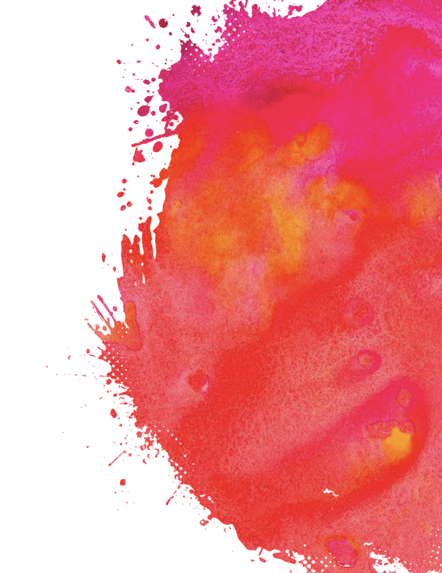
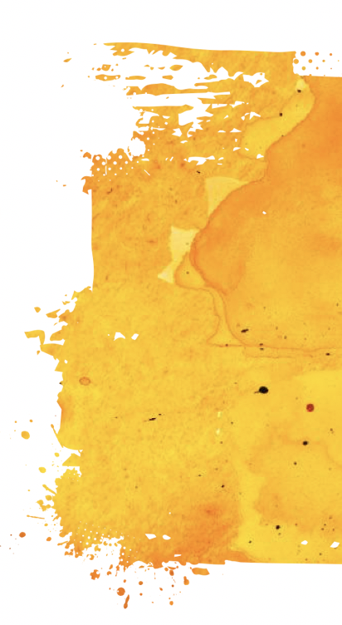
Content
Introduction: Project Demo (Video)
Background: Neural Style Transfer
Model
App(Server) Design
Output: 4 selected styles

Slide 3
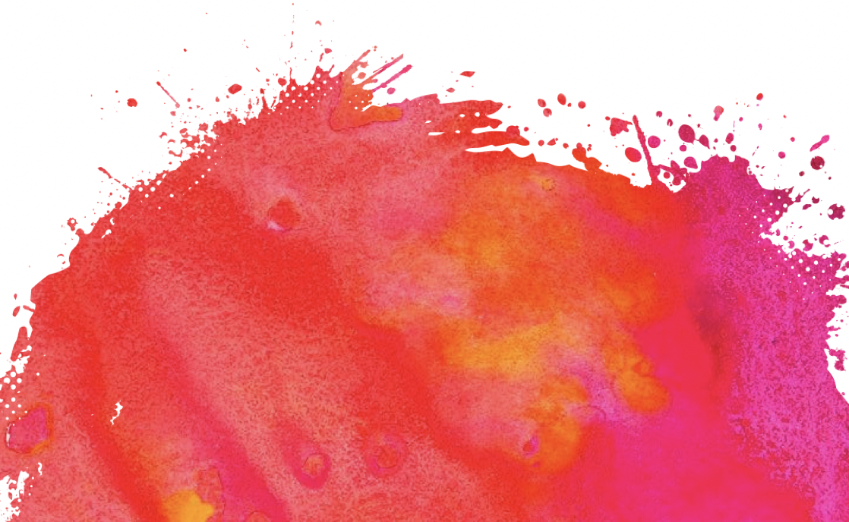
Introduction
Goal: Create an app to convert photos into artworks based on existing paintings.
App Functions:
Styles: 4 famous paintings in different styles
Technique: Neural Style Transfer
Choose style image
Start Transformation
Upload Photo
Show Results

Slide 4
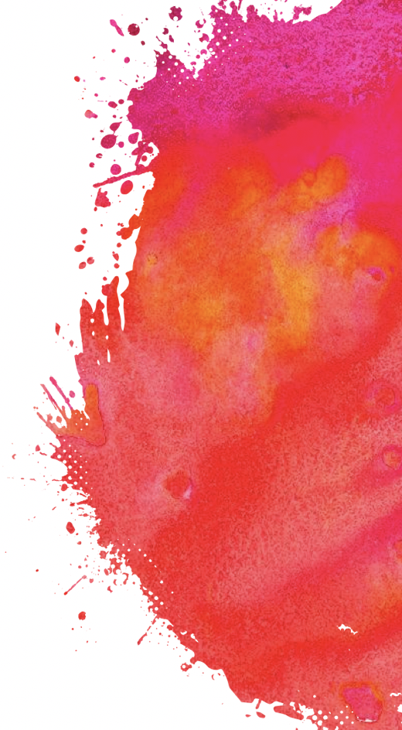
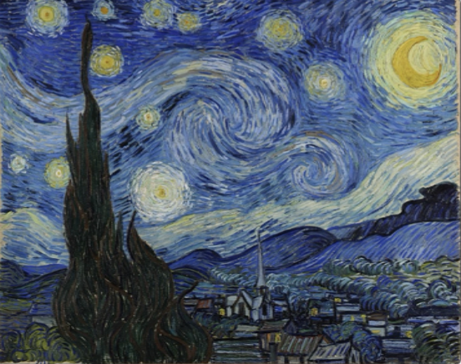
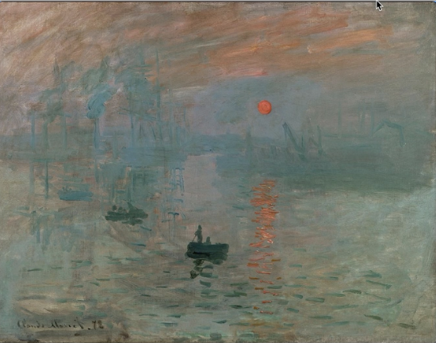
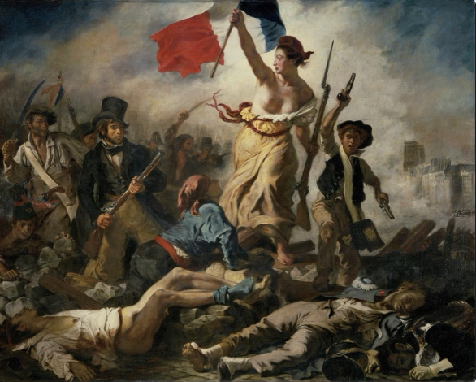
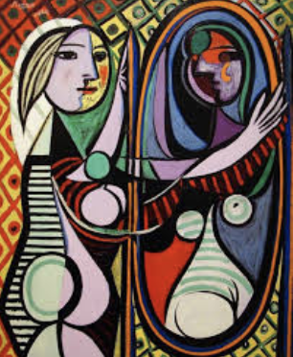
1. Starring Night (Van Gogh)
2. Impression- Sunrise (Claude Monet)
3. Liberty Leading the people (Eugène Delacroix)
4. Girl before a Mirror (Pablo Picasso)

Slide 5
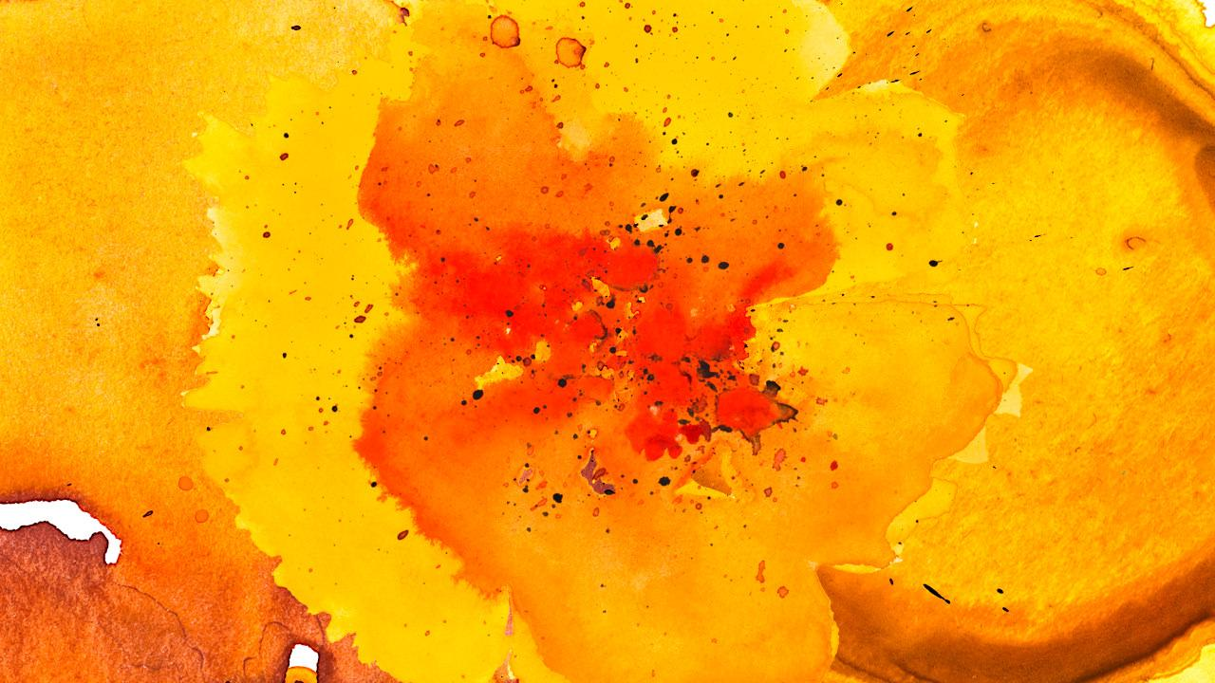
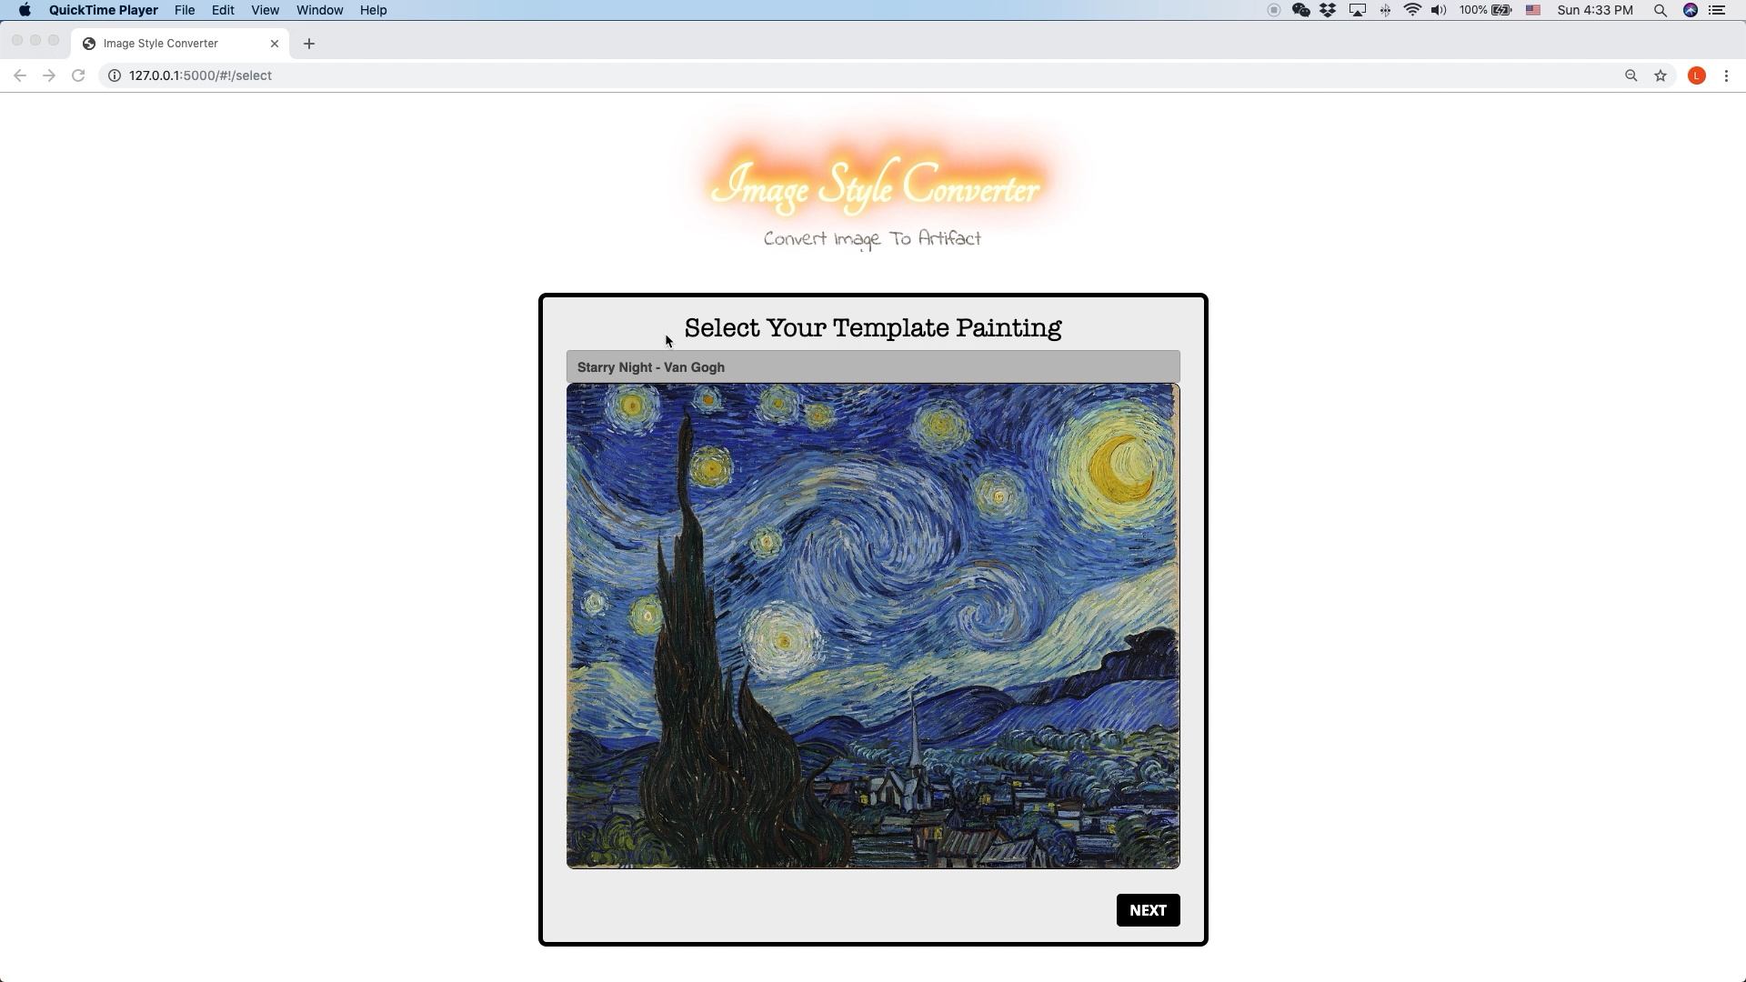

Slide 6

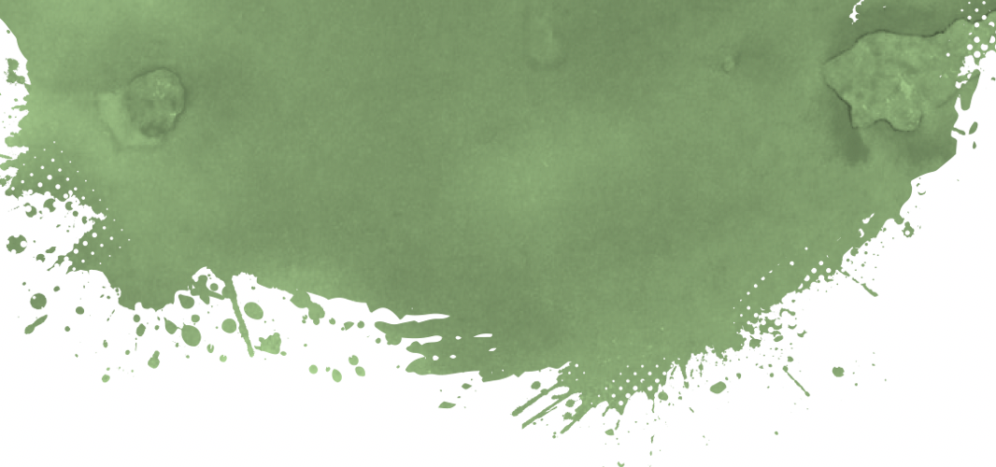
Background
Several terms to understand:
Neural Style Transfer
VGG Networks
Content/Style
CNN
Allow us to learn far fewer parameters in later layers
Mostly applied to analyzing visual imagery
Use deep learning to compose images in the style of another image
A CNN that is trained on more than a million images from the ImageNet database
Feed in input tensor to the model- VGG19
Convert Content based on the Style selected

Slide 7
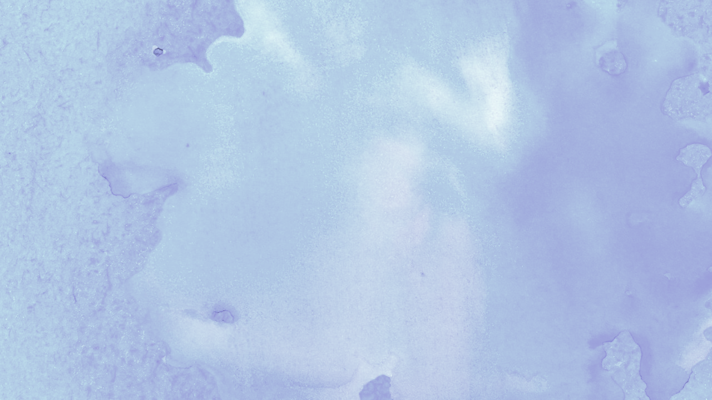

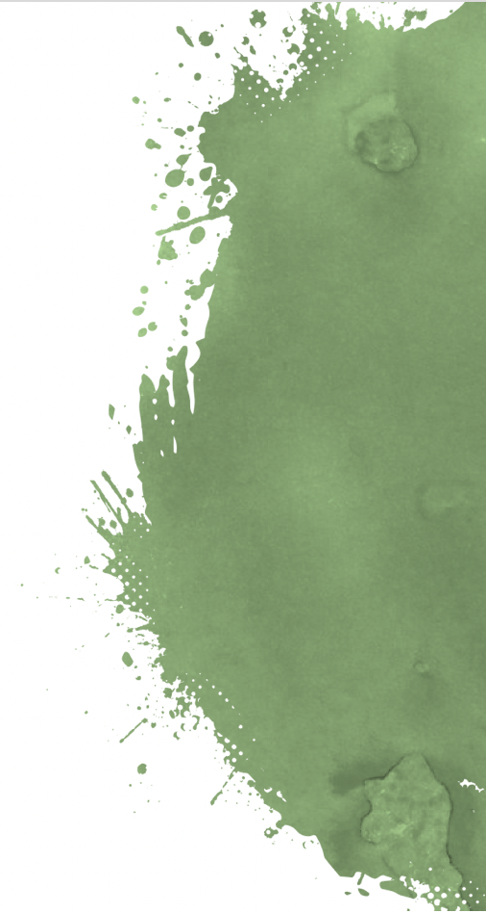
NST (Neural Style Transfer)
Use deep neural networks to perform image transformation
Common Uses: transfer photographs to supplied paintings
Notable Apps: DeepArt and Prisma.
Prior to NST: ”Image Analogy”, requires pair of images–a photo and an artwork depicting that photo; however, such a training pair rarely exists in practice.

Slide 8
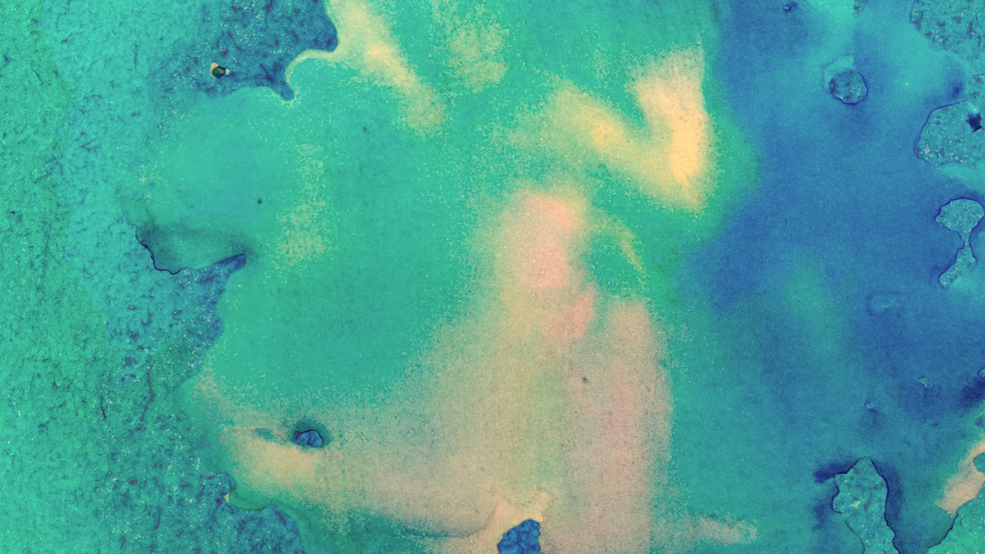
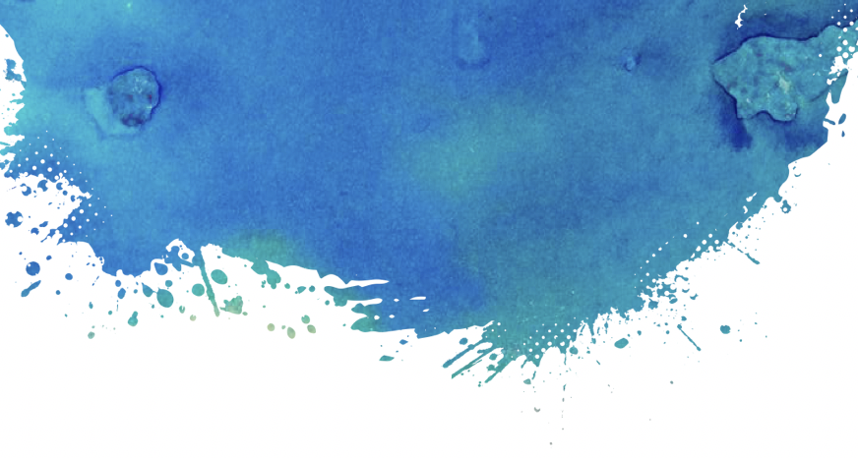

Model
Goal: minimize both content/style distance
Lcontent: how different the contents are
Lstyle: how different the styles are
The final image is synthesized by finding an image that simultaneously matches the content representation of the photograph and the style representation of the respective piece of art
VGG19 model
Gradient Descent (Adam Optimization): used to minimize loss function
Input Image
Loss function:
𝐿𝑐𝑜𝑛𝑡𝑒𝑛𝑡
Loss function:
𝐿style
(Minimize)
Desired Content Image
Desired Style Image
(Synthesize)

Slide 9
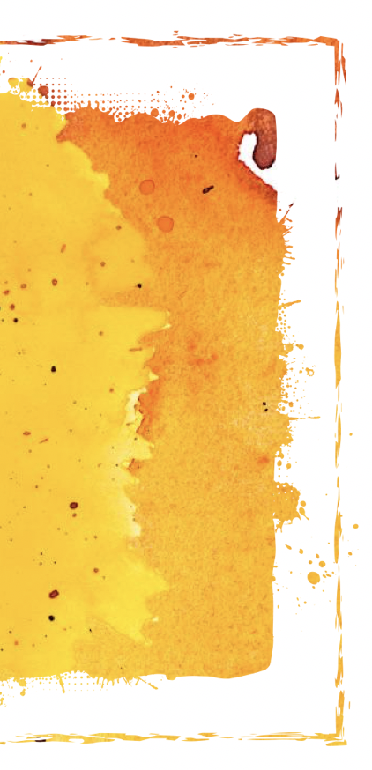

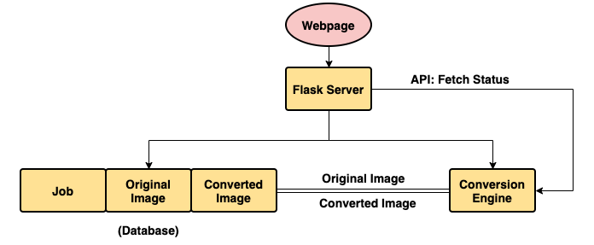
App Design
Database: store each request, original image, and converted image
Conversion Engine: the image converter (model)
Server: serve webpage, hold APIs(upload image, show status etc.)
* Assisted by QC

Slide 10
Output
(using 1000 iterations to minimize loss function)

Slide 11

1. Starring Night

Slide 12
2. Impression-Sunrise

Slide 13
3. Liberty Leading the People

Slide 14
4. Girl before a mirror

Slide 15
Appendix
Reference:
Special thanks to QC, who helped to design and create an App
1. Leon A. Gatys, Alexander S. Ecker, Matthias Bethge. 2015. A Neural Algorithm of Artistic Style. September.
2. Yuan, Raymond. 2018. Neural Style Transfer: Creating Art with Deep Learning using tf.keras and eager execution. August. https://medium.com/tensorflow/neural-style-transfer-creating-art-with-deep-learning-using-tf-keras-and-eager-execution-7d541ac31398.

